Slide 1
Taiwanese Bankruptcy Prediction Dataset
Dawid Pałka
Jan Jurasz

Slide 2
Dataset
95 input features, one target feature.
No missing values.
Class balance:
Financially stable: 96.77 % of the dataset
Financially unstable: 3.23 % of the dataset

Slide 3


Categorical features
'Bankrupt?', ' Liability-Assets Flag', ' Net Income Flag’
0 is a positive value for a firm’s financial health.
All of the described firms suffered losses in the last two years.

Slide 4
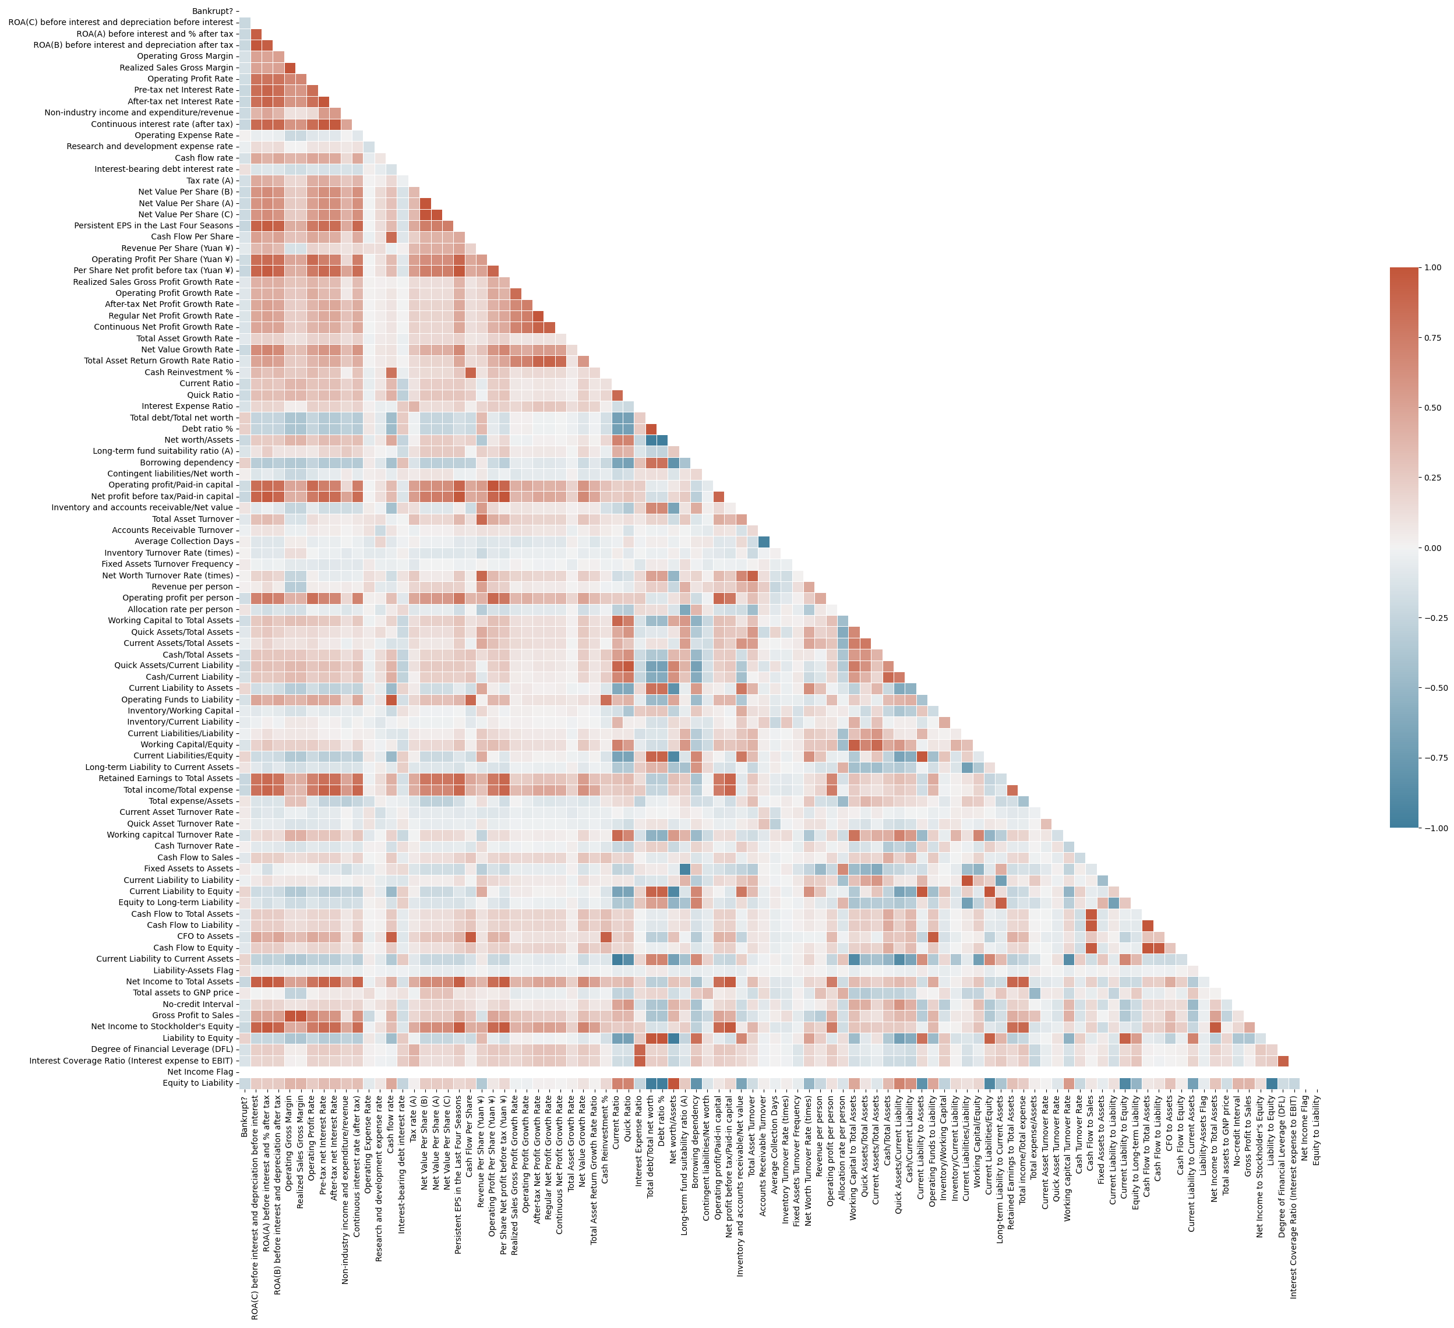
Correlating features:
Highest positive correlated features:
Debt Ratio
Current Liability to Assets
Borrowing Dependency
Current Liability to Current Assets
Liability to Equity
Current Liabilities/Equity
Highest negative correlated features:
Net Income to Total Assets
ROA(A) before Interest and % After Tax
ROA(B) before Interest and % After Tax
ROA(C) before Interest and % After Tax
Net Worth/Assets
Persisten Eps in the last four seasons

Slide 5
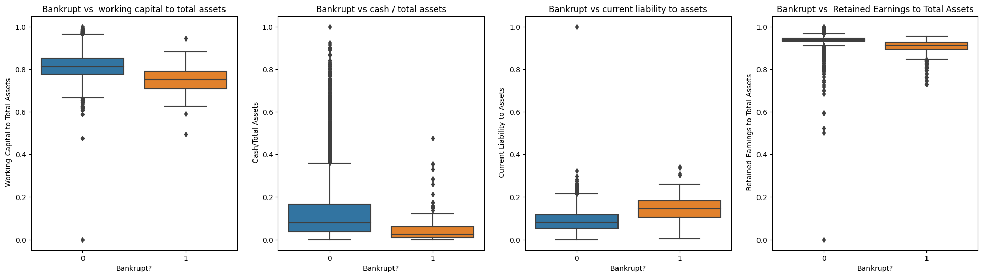
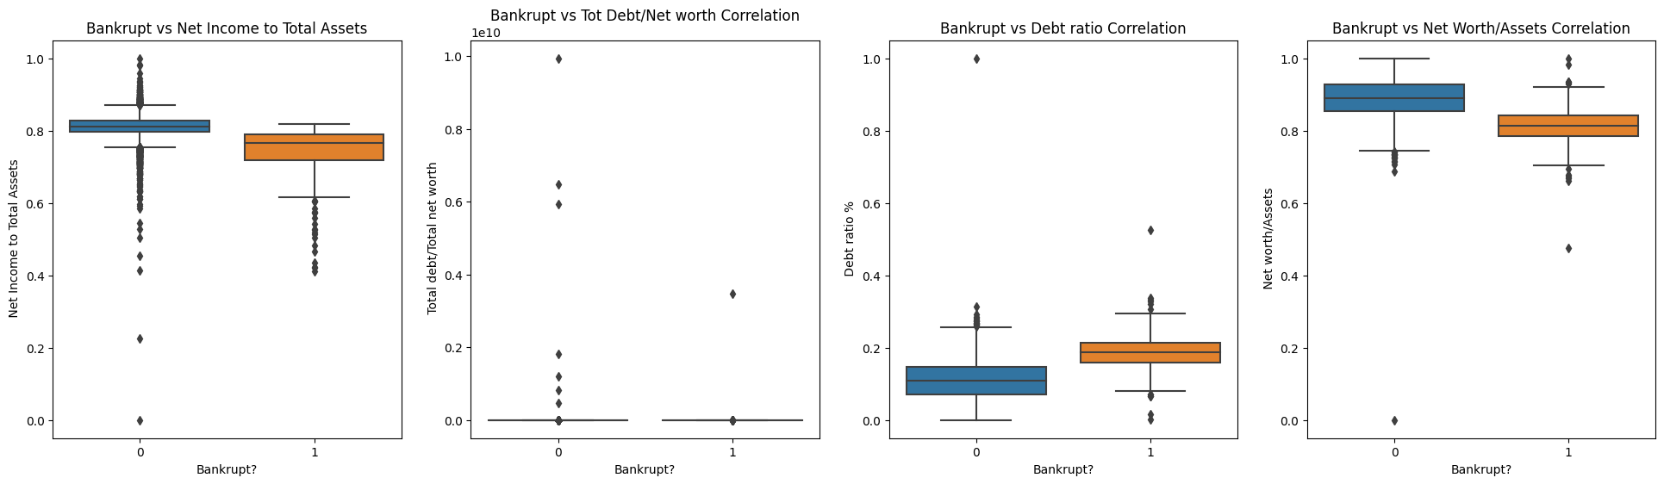

Slide 6
Findings
An organization cannot guarantee not being bankrupt, despite having several assets.
Only a small numer of organizations went bankrupt in the years 1999 – 2009.
The companies in the data have been experiencing losses for the last two years, as their net income shows negative figures.
“Debt Ratio %, Current Liability To Assets, Current Liability To Current Assets„ are highly correlated to target attribute.
There are several correlations among the top 12 attributes

Slide 7
Findings
All three ROAs are positively correlated amongst each other.
Net value per share A,B and C are highly correlated between each other.
' Debt ratio %', ' Net worth/Assets' are negatively correlated.
After tax net interest rate and pre tax net interest rate are also highly correlated.
' Non-industry income and expenditure/revenue' is negatively correlated with Operating Profit Rate.
- ' Operating Profit Growth Rate',' After-tax Net Profit Growth Rate' and ' Regular Net Profit Growth Rate' are also highely correlated.
- ' Per Share Net profit before tax (Yuan ¥)' and ' Persistent EPS in the Last Four Seasons' are highly correlated.
There are multiple multicollinearities in the dataset, so regression model will not work properly on this dataset.

Slide 8
Finding Best Model
To find best model we take into consideration 4 types of models
- Classic logistic regression (using sklearn.linear_model librarry)
- Decision tree model ( using sklearn.tree)
- Neural network model (using tensorflow)
- Gradient boosting model (using XGBoost librarry)

Slide 9
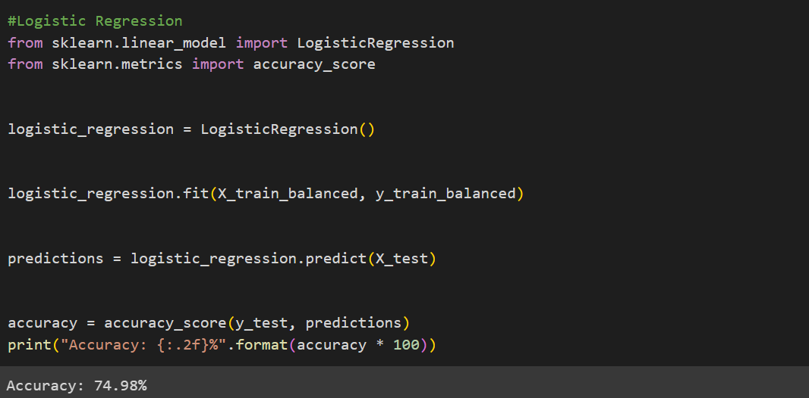
Classic logistic regression
Logistic regression is a statistical model that predicts binary outcomes by estimating the probability of an event occurring based on input features, using a logistic/sigmoid function to map values to the [0,1] range.
We got the worst accuracy using this model.
Final result : 74.98% accuracy

Slide 10
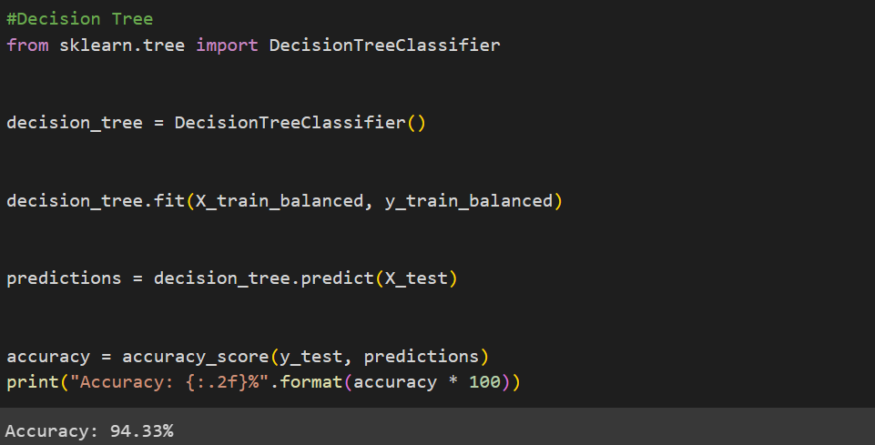
Decision tree model
Decision tree model is a predictive algorithm that partitions data into hierarchical structures, making sequential decisions based on features to classify instances into binary outcomes.
We got mid accuracy using this model
Final result : 94.33% accuracy

Slide 11
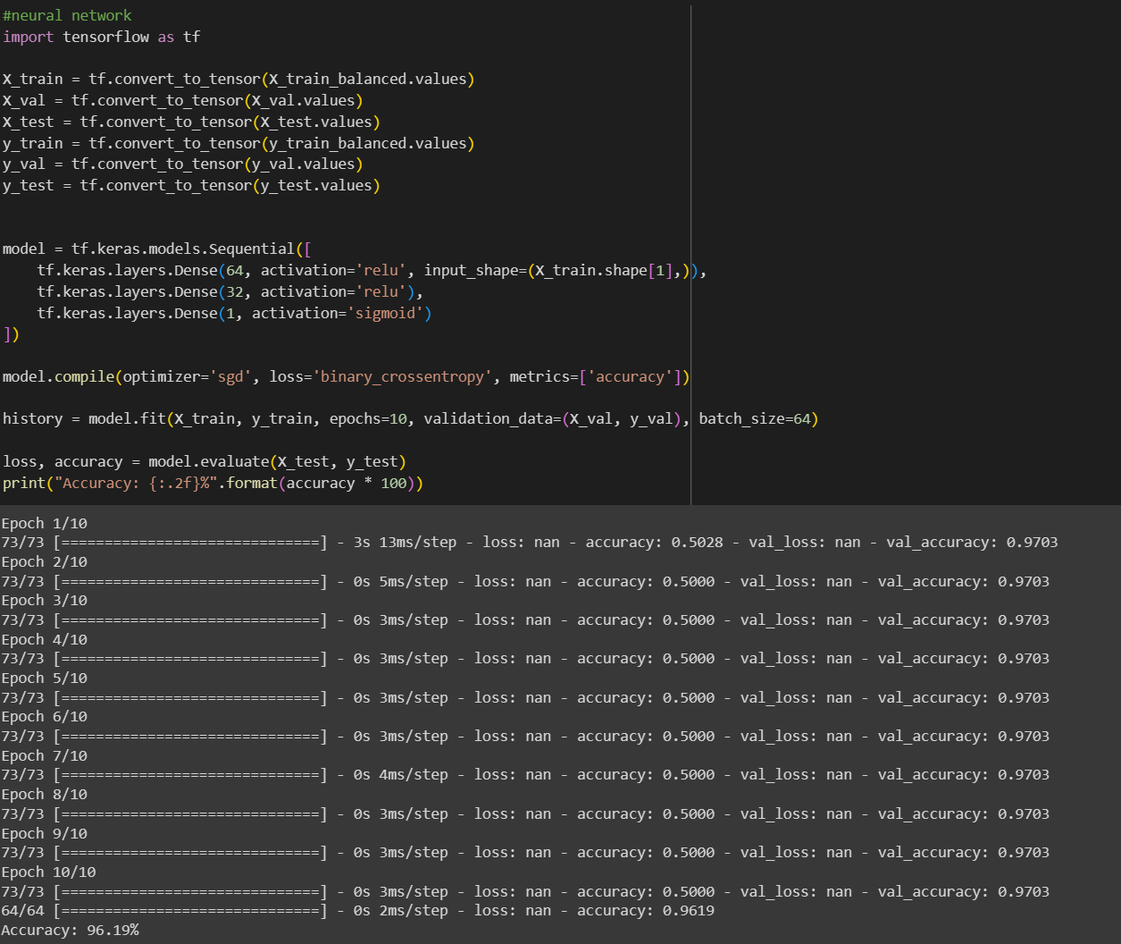
Neural network model
Neural network model learns complex patterns through interconnected layers, employing activation functions and weights to classify binary outcomes by transforming input data iteratively.
We got mid accuracy using this model but this model accuracy was very close to best resoult.
Final result : 96.19% accuracy

Slide 12
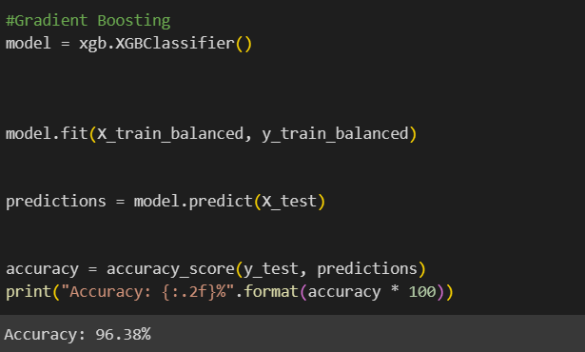
Gradient boosting model
Gradient boosting algorithm sequentially combines weak classifiers to predict binary outcomes, optimizing by minimizing errors through iterative tree ensemble building with enhanced regularization and parallel computing.
By this model we found best resoult.
Final result: 96.38% accuracy

Slide 14
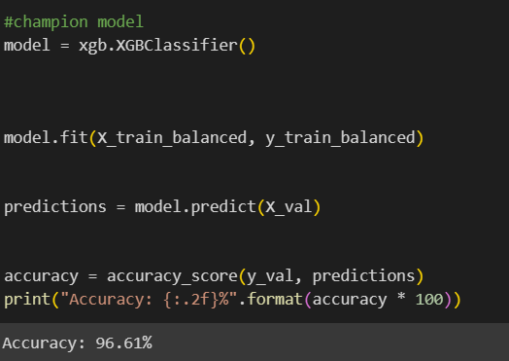
Champion model
The championship model was used to predict values in the validation set, resulting in a final accuracy of 96.61%

Slide 15
Thank you for your time

